Slide 1
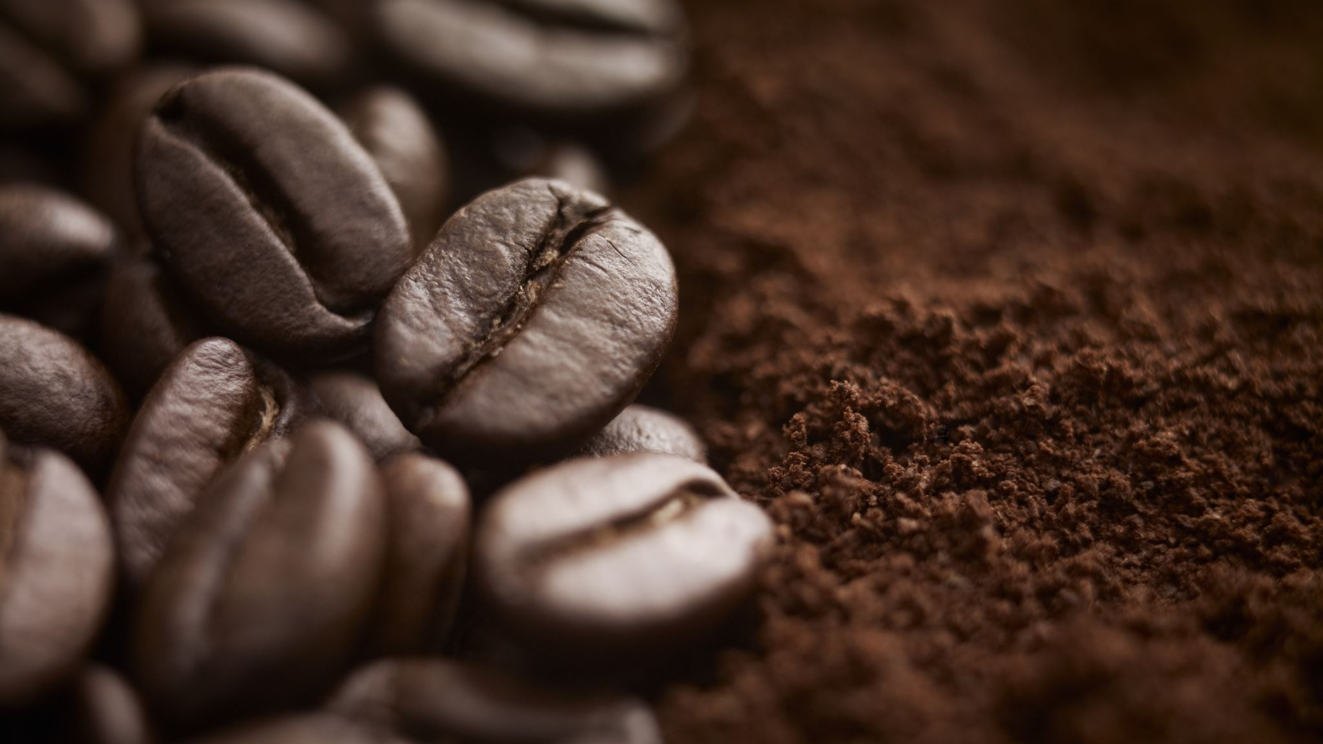
COFFEE COFFEE COFFEE
COFFEE & ML: CONTEXT, INSPIRATION, SCRAPING, PLAN
github.com/mrpotatocode/COFEE_COFFEE_COFFEE

Slide 2

CONTEXT

Slide 3

Coffee Data + ML = ?
Thinking about Coffee
Not all coffee is the same
Different species (think citrus, lemon vs orange)
Different varieties (think wine, pinot noir vs cab franc)
Different terroirs
Not all coffee is processed the same
Left out in the sun “Natural”
Washed
Weird anaerobic processes that smell like yogurt?
Not all coffee is the same quality
Coffee “grades” (usually based on bean size)
Single Origins
Single Farms
Not all coffee is traded the same
Certifications
Price
Relationship
Not all coffee is roasted the same
Not all coffee tastes the same
Tasting Notes

Slide 4
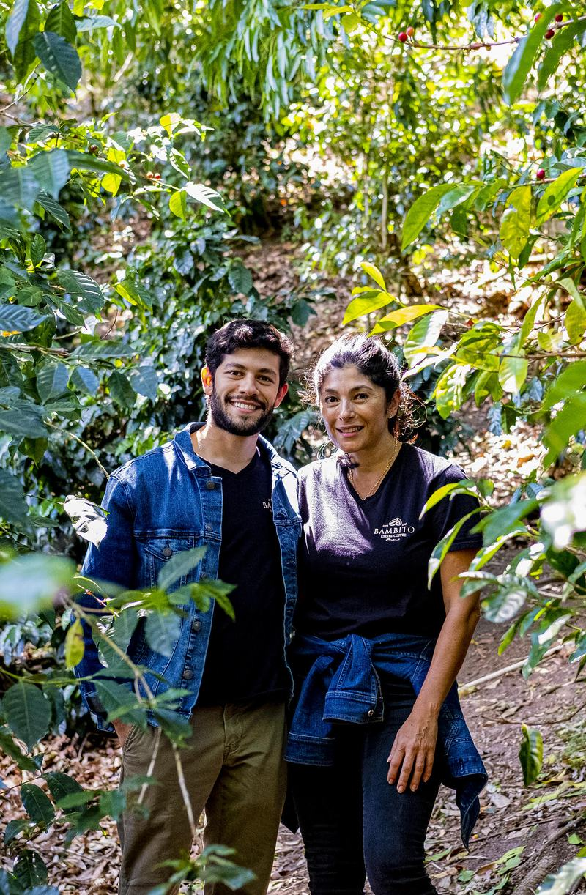


So What? Why Care?
Coffee is critical to many people’s livelihoods
One of the most traded commodities per year
Coffee rituals share a deep human history
Help reclaim coffee from its colonial legacy
Produced almost entirely in the global south
Backbone of many African countries’ economies
Relationships in coffee create sustainability, rather than exploitation
Cheap coffee results poor living, working conditions
Put a face to farmers and producers around the world
Climate change is coming
Ivan and Priscilla Gonzalez
Bambito, Volcán Baru, Panama

Slide 5
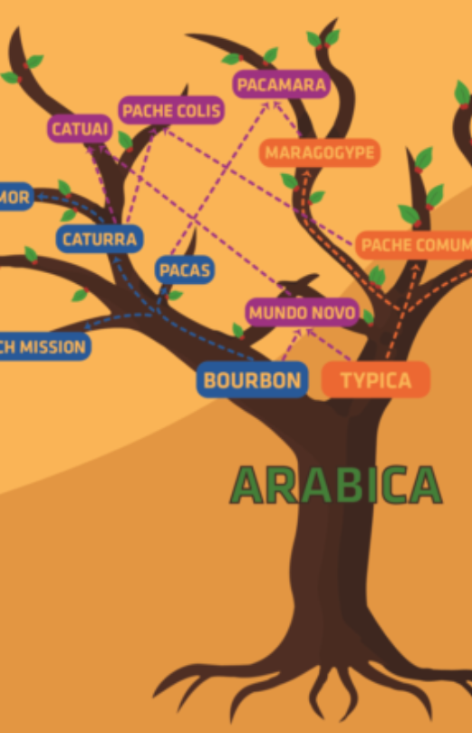
The Terms that Matter
Country and Region of production, where the coffee was cultivated
Variety, the subspecies cultivated through selection. Variety may also be referred to as varietal, a single instance of a variety. There are an unknown number of varieties in the world, but there are a handful of popular, well-identified varieties whose morphologies are well-documented
Harvest Characteristics, including the following: ripeness colouration (e.g. black, red, orange, yellow, white—from most to least ripened), farm’s location (latitude and longitude) and terroir (i.e. temperature, rainfall, soil composition, days of sunshine, meters above sea level [MASL]), season of harvest, and picking methods (e.g. hand, stripping, mechanical).
Processing (dry, wet, honey, pulp) and Drying (patio, raised, mechanical) methods
Roast, where all beans have been roasted (i.e. have undergone the Maillard Reaction)
Taste, as identified by cupping, to identify tasting traits (e.g. sweetness, acidity, mouthfeel, balance, flavour), tasting groups (e.g. citrus, berry, stone fruits, sweet, savoury, floral), and tasting notes (e.g. chocolate, raspberry, lemon, black tea, hazelnut, velvety). Overlap can exist both vertically and horizontally within this hierarchy

Slide 6
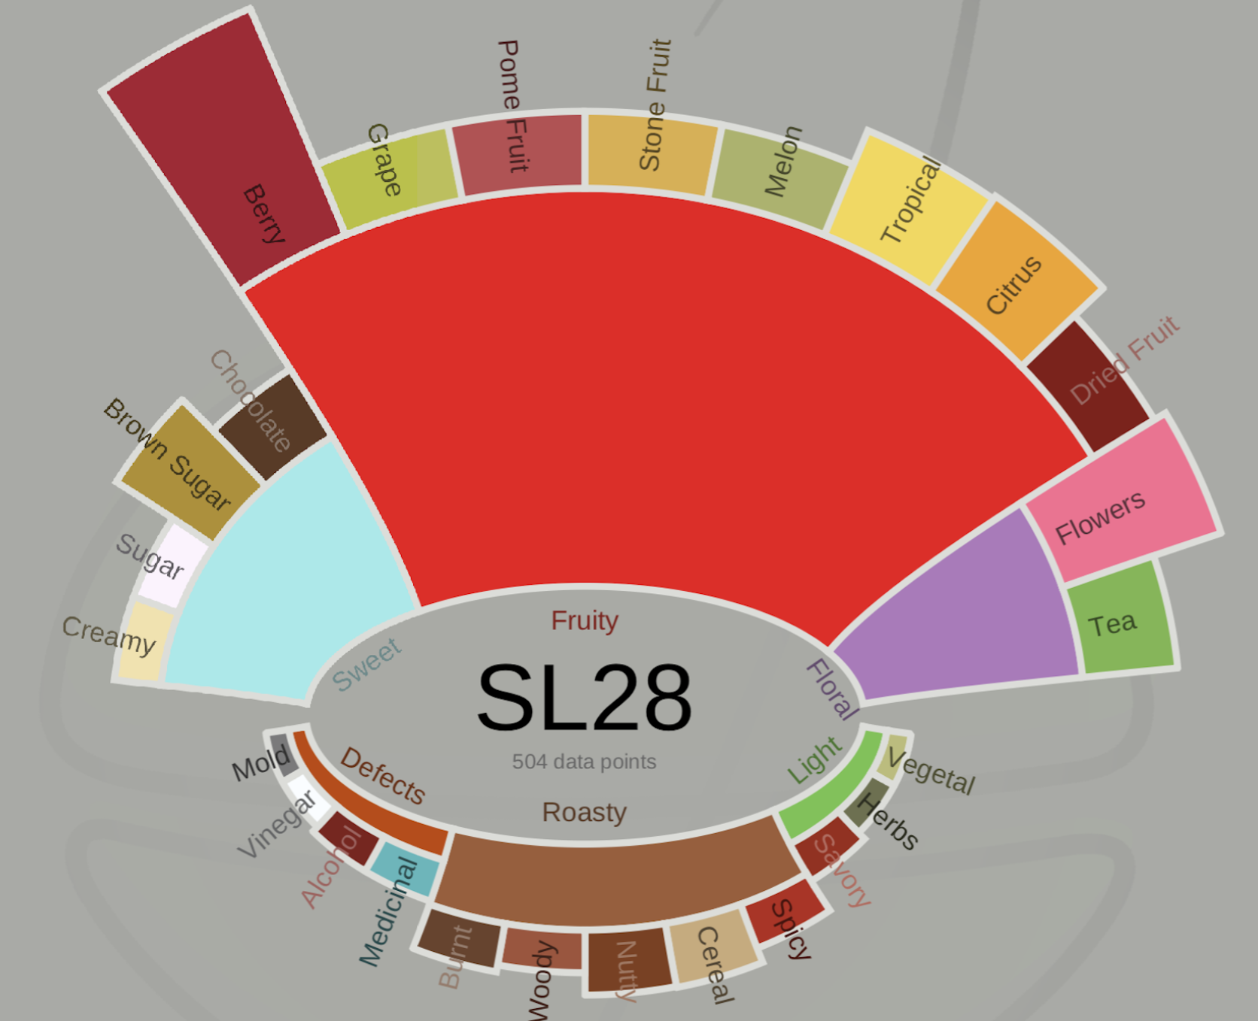
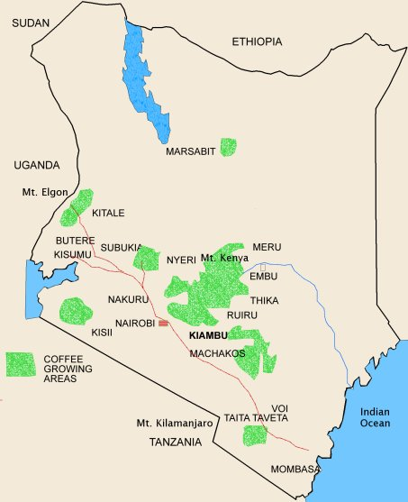
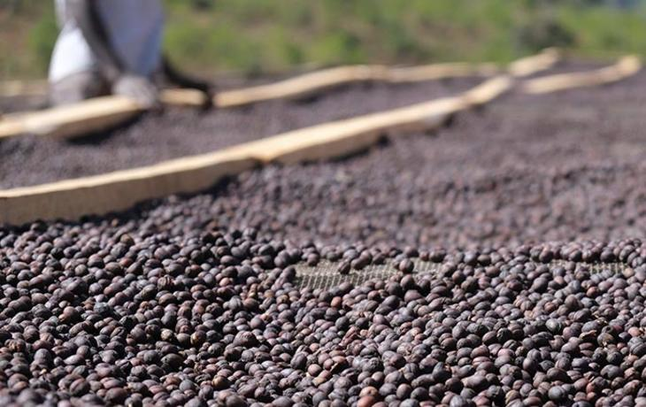

Use Coffee Attributes to Predict Tasting Notes
Will taste like Black Currant, Jasmine, and Brown Sugar
A Kenyan SL-28 from Nyeri
Dried in the sun on raised beds
+
=
Jonathon Gagné @ University of Montreal

Slide 7

INSPIRATIONS

Slide 8
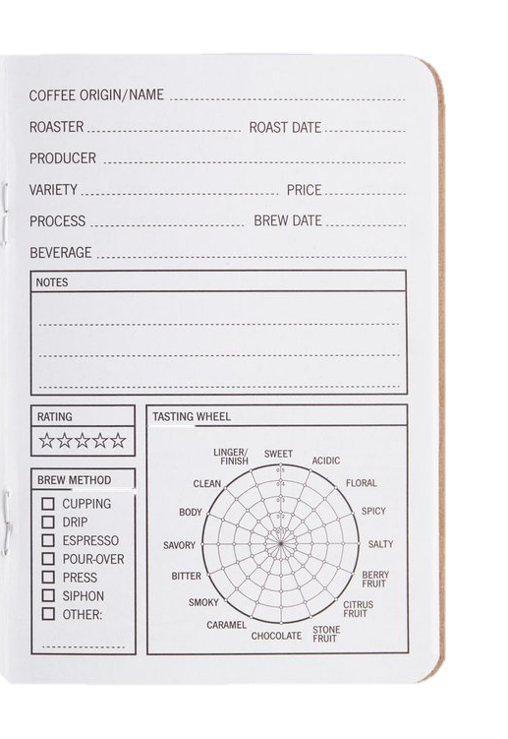
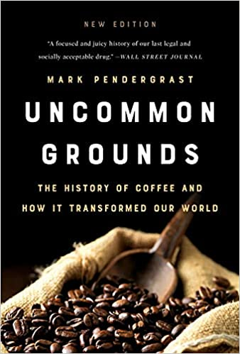
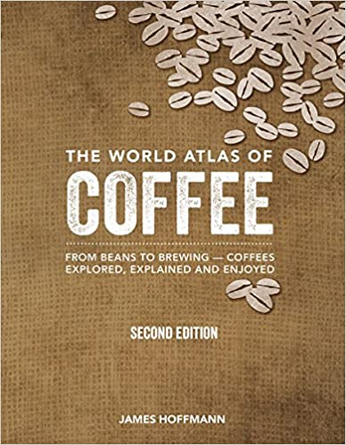
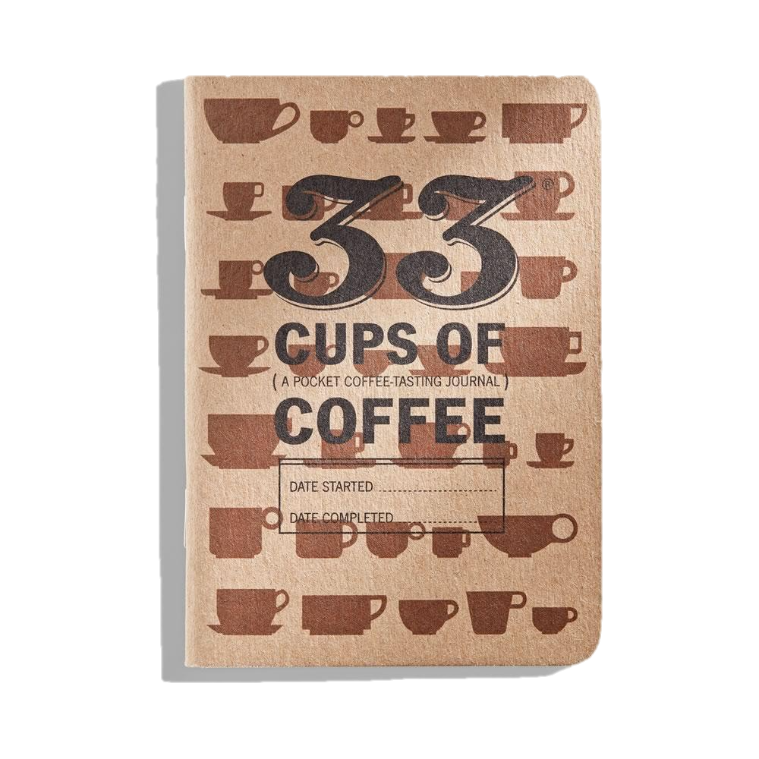
Idea Formations
These coffee journals by Dave Selden at 33 Books started my personal journey with coffee data. Since 2017 I have logged one entry for every unique coffee I have tasted
Arguably the most comprehensive book on the history of coffee and its societal impact is Mark Pendergrast’s Uncommon Grounds
Newer to the book scene, James Hoffmann’s The World Atlas of Coffee is written through the lens of Single Origin coffee, with pages devoted for every coffee producing country in the world, and nearly all of today’s terminology

Slide 9
Validity through Literature
Tasting Notes are objective, not subjective:
Not All Flavor Expertise Is Equal: The Language of Wine and Coffee Experts, Croijmans, I., & Majid, A. (2016)
Blind taste and aroma tests are consistent amongst experts:
Evolution of sensory aroma attributes from coffee beans to brewed coffee, Bhumiratana, N., Adhikari, K., & Chambers, E. (2011)
Cupping is the preferred means of producing tasting notes:
The “Coffee Doctors”: The Language of Taste and the Rise of Rwanda’s Specialty Bean Value, Goldstein, J. E. (2011)
SCAA Protocols | Cupping Specialty Coffee, SCAA (2015)
Mechanical tongues (nearly) differentiate geographical origins for coffees of the same variety:
Discrimination and geographical origin prediction of washed specialty Bourbon coffee from different coffee growing areas in Rwanda by using electronic nose and electronic tongue, Flambeau, K. J., Lee, W.-J., & Yoon, J. (2017)
Statistical / machine learning models have already been used in conjunction with coffee attributes:
Coffee Terroir: Cupping Description Profiles and Their Impact Upon Prices in Central American Coffees, Conley, J., & Wilson, B. (2018)
How Coffee Varietals and Processing Affect Taste, Gagné, J. (2019, September 2)
A Review of Coffee Data: Grades and Flavors: How flavors potentially impact coffee grading, McKeon Aloe (2020, November 20)

Slide 10

SCRAPING

Slide 11
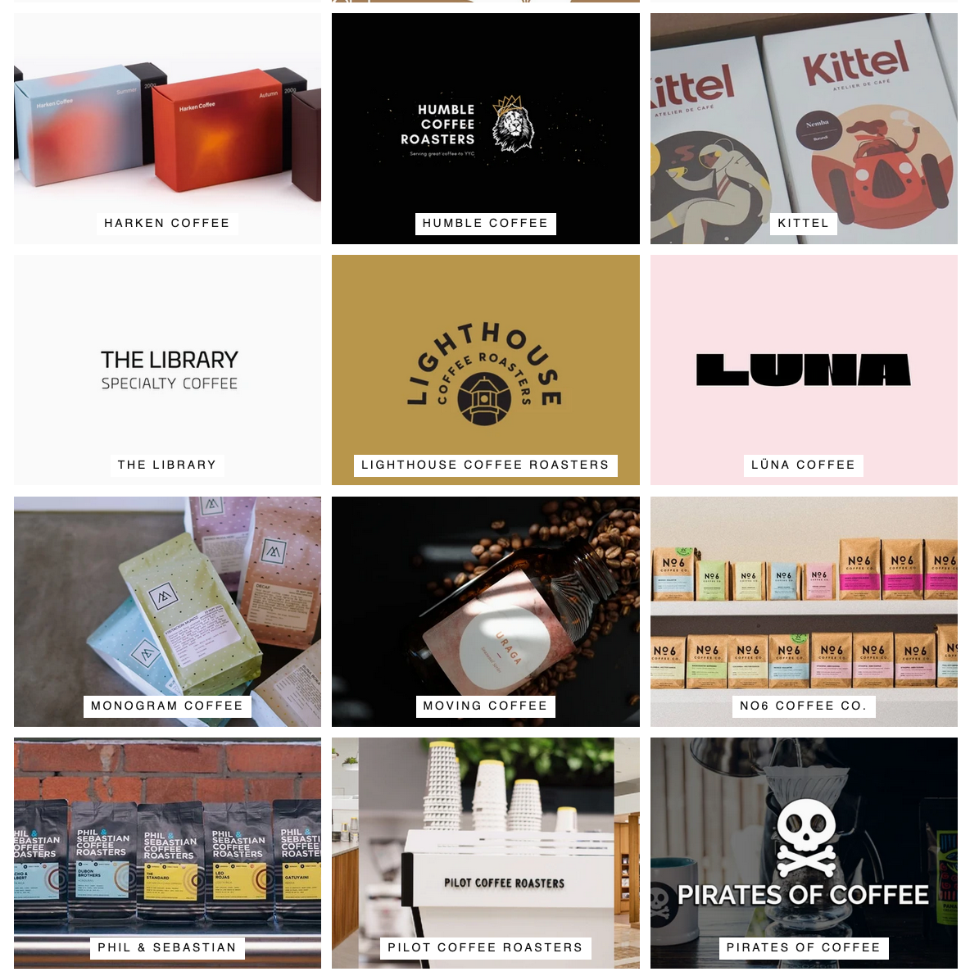
Eight Ounce Coffee
Pros:
Many roasters
Updated fast enough (weekly)
Can duplicate ~80% of code between roasters
Cons:
Huge HTML overhead
Inconsistencies
Less personal
Might miss a couple of special coffees only reserved for original website or subscribers
Roasters:

Slide 12

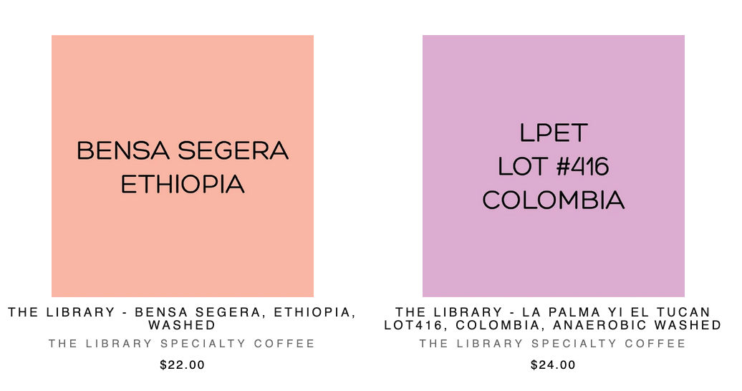
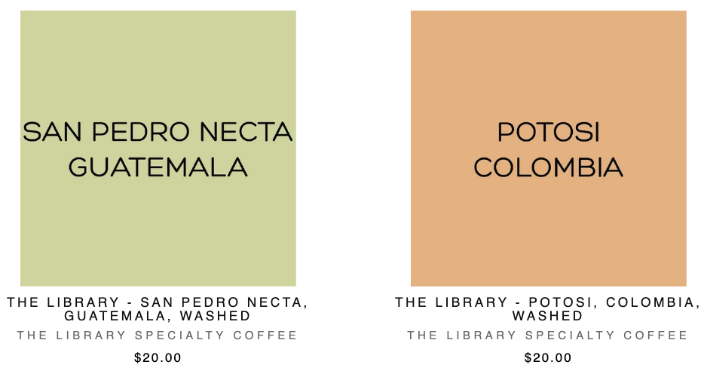


Eight Ounce Coffee
Coffees:
Quantitative Details:
Region: Cundinamarca Variety: Castillo, Caturra, Colombia Processing: 'Lactic' Anaerobic Washed Altitude: 1350m Cup: Prune, Red grape, Toffee
Qualitative Details:
This lot comes from La Palma & El Tucan's (LPET) prestigious Neighbours and Crops program. What that means, is LPET hasn't actually produced this coffee and rather they're assisting in the production, teaming up and empowering Victor Hernandez, a coffee producer who lives in Cundinamarca, Colombia. LPET has created a brilliant business model focused on their community and empowering the small holder producers surrounding them in many ways.

Slide 13
Eight Ounce Coffee
Scraping Process:
Every week, download html for current coffees for each roaster
rvest to select correct html_node()
use [id/class = ‘__’] to find the desired information, rather than traverse the HTML tree
Turn listed coffees into URLs
https://eightoucecoffee.ca/collections/... + roaster-name + coffee-name
Check that each URL resolves, skip if not
Loop through each coffee URL, grab attributes and write table
rvest to select correct html_node()
Separate each attribute into columns
Save qualitative data elsewhere
Parse either Coffee Names or Region into Country when possible
parseName vs regex vs other?
Merge all dataframes
Save CSV with scrape date
Output:
Roaster | CoffeeName | Country | Region | Variety | Processing | Altitude | TastingNotes
The Library Specialty Coffee | San Pedro Necta, Guatemala, Washed | Guatemala | Huehuetenango | Caturra, Bourbon, Pache | Washed | 1400 - 1850 m | Milk chocolate, Apple, Fig
The Library Specialty Coffee | Bensa Segera, Ethiopia, Washed | Ethiopia | Sidamo | Heirloom | Washed | 2100 - 2300 m | Yellow peach, Black berry, Floral
The Library Specialty Coffee | Potosi, Colombia, Washed | Colombia | Cauca | Caturra | Double Fermentation Washed | 1400 - 1860 m | Citrus fruit, Molasses, Hazelnut
The Library Specialty Coffee | La Palma yi El Tucan lot416, Colombia, Anaerobic washed | Colombia | Cundinamarca | Castillo, Caturra, Colombia | 'Lactic' Anaerobic Washed | 1350m | Prune, Red grape, Toffee
Where is the producer?

Slide 14
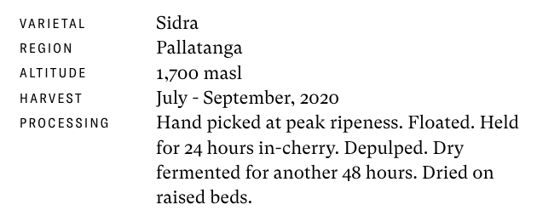
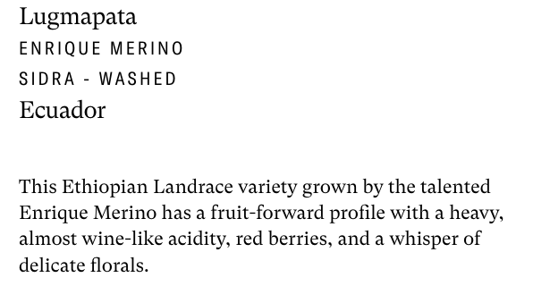
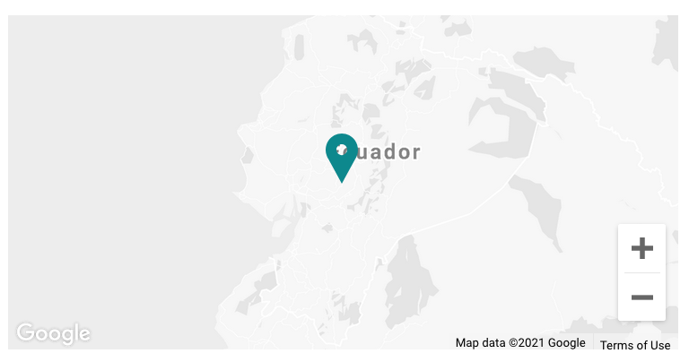
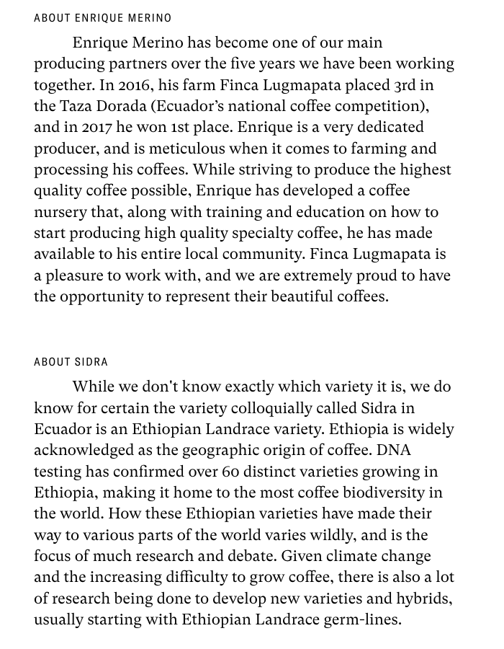
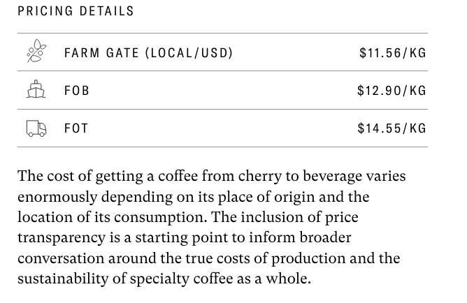
SEY Coffee
What makes SEY special?
Data richness:
Varietal
Region
Farm Location
Altitude
Harvest Date
Harvest Details
Processing
Processing Timeline
Tasting Notes
Producer, relationship, awards
Varietal History
Pricing Details
Oh yeah, they taste phenomenal too
🥇

Slide 15

PLAN

Slide 16
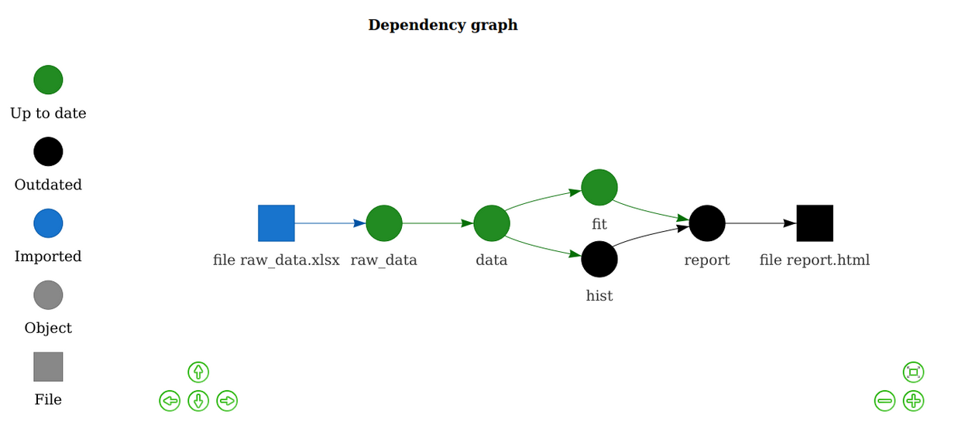
What’s Next?
Automate it.
Running R Scripts on a Schedule with GitHub Actions:
Simon Couch, 2020: https://blog.simonpcouch.com/blog/r-github-actions-commit/
usethis package
GitHub actions
How often
Initialize R
Run a script
Save a result
Apparently that’s it!
No questions please, I haven’t done this yet.
Using drake to automate data pipelines and model reproducibility
https://docs.ropensci.org/drake/
Make a drake_plan
Read the files in
Build more permanent tables
Add more robust data when possible
Need all the geo data…
Write models
Execute models
Re-run plan anytime?
New model results, up to date data
No questions please, I haven’t done this yet.
Make it reproducible

Slide 17
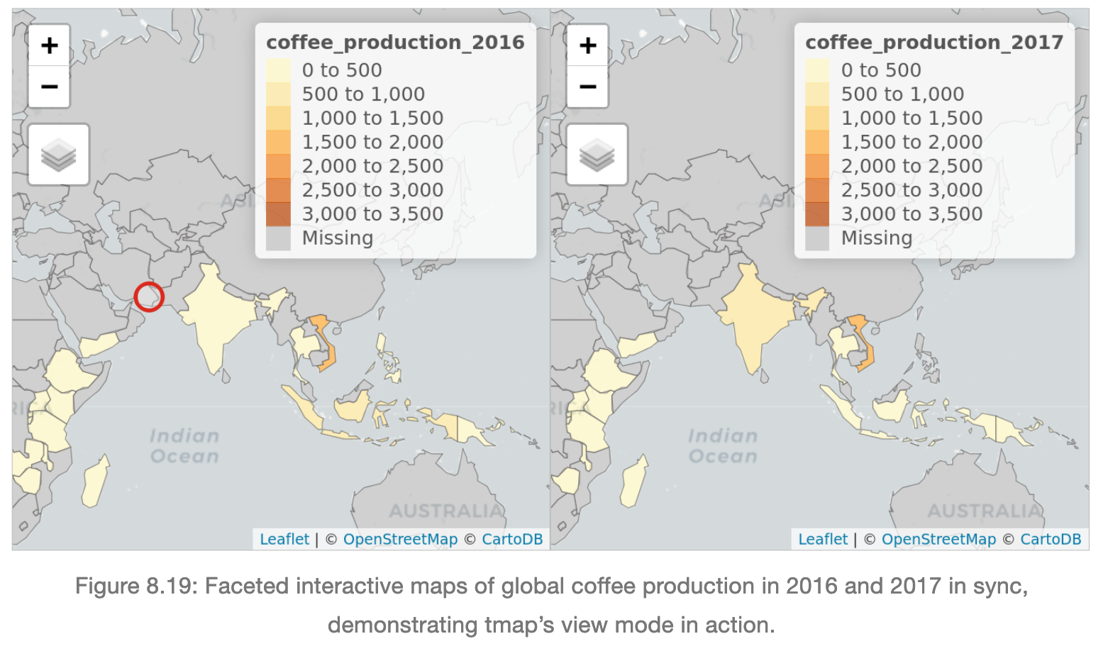
Eventually…Build a Shiny App
Vietnam is 80% Robusta… the cheapest coffee species
Geocomputation with R, Robin Lovelace, Jakub Nowosad, Jannes Muenchow (2019)

Slide 18




Questions
Thanks Keli

